Slide 1

Mixed Reality Lab - Project Proposal Presentation
MR Immersive Telemanipulation
Arda Duzceker - Jonas Hein
Supervised by: Dr. Roi Poranne, Dr. Federica Bogo

Slide 2
Introduction
(Immersive) robotic teleoperation
Manipulated by a remote user
Assist people in everyday tasks
HoloLens/MR makes different types of manipulation methods possible.
Seamless integration of holograms to the real world
Interaction with the holograms
Optional VR-like experience
Hand tracking

Slide 3
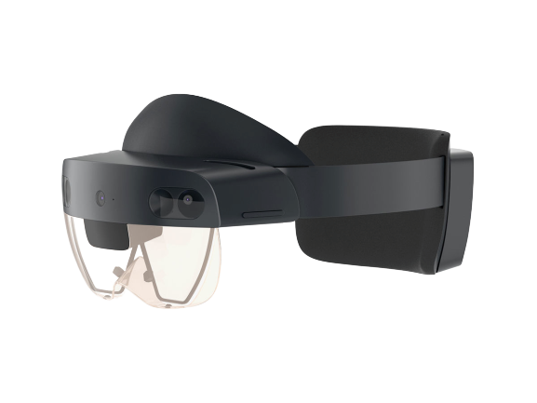
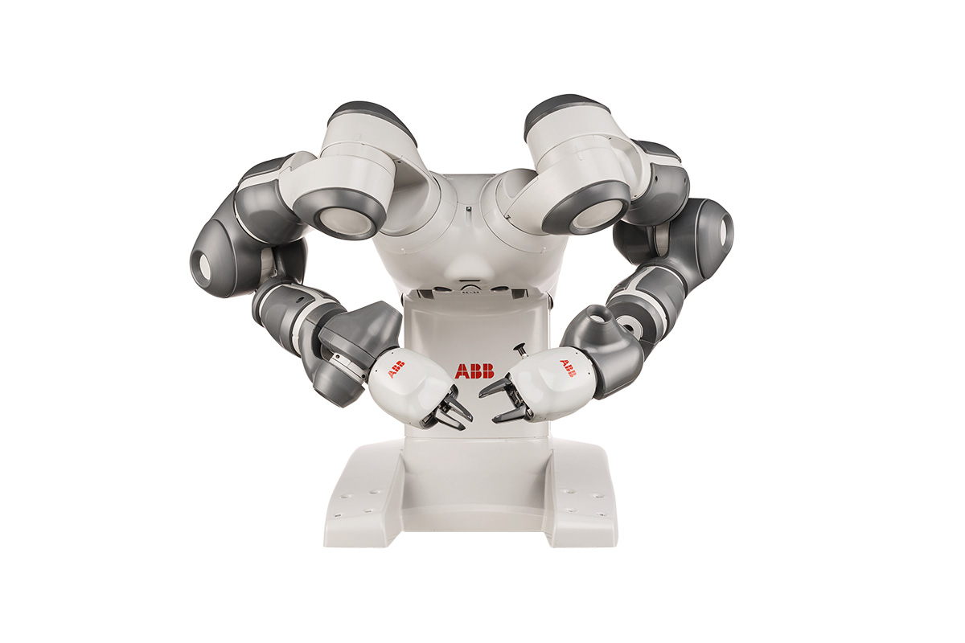
Project Description
Two Devices
HoloLens 2
ABB YuMi
Develop two interaction methods that enables a user wearing the HoloLens to control the ABB YuMi.
External Holographic Operation
Internal Immersive Operation

Slide 4
A little motivation...
You’re on a train, on your way home.
There is a kitchen robot like YuMi at home. You’re dying for some pancakes.
You wear the HoloLens, your kitchen countertop and robot appears as a hologram.
Now, using holographic items in your virtual kitchen, you can give tasks to the robot.
Mix some virtual ingredients, place a virtual pan, start cooking virtually.
Your robot does whatever you do, in your real kitchen.
At the same time, you can watch the action from the robot’s camera.
Voila! Your pancakes are ready before you reach home.

Slide 5
External Holographic Operation
Visualize a hologram of the YuMi and its workspace.
Animate the hologram, such that it shows the robot’s movements in real-time.
Enable the user to manipulate the robot’s arms
by clicking to a location
by dragging the arms of the holographic robot
Enable the user to place virtual cubes in the holographic workspace and command the robot to place real cubes at the corresponding positions in real workspace.
i.e. the assembly task
Notes:
WHEN THE USER IS IN A REMOTE LOCATION

Slide 6
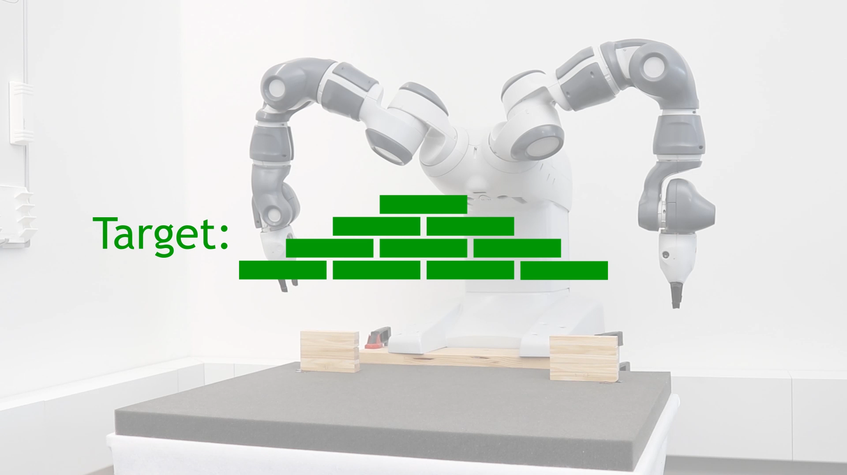

Slide 7
External Holographic Operation
When the user stands in front of the robot, align the hologram with the actual robot.
Given a similar assembly task, animate the hologram ahead of time, such that the user knows what the robot is going to do next.
Notes:
WHEN THE USER IS FACING THE REAL ROBOT

Slide 8
Oops! Something is going wrong in the kitchen...
You need to take the action into your own hands.
Use your other option of becoming the robot itself.
You go into VR mode and see your real kitchen from the perspective of the robot.
As if your arms are the robot’s arms and your eyes are the robot’s camera.
Now you can flip your pancakes yourself. Be careful though!

Slide 9
Internal Immersive Operation
Develop a user interface for switching between external and internal modes.
Stream the RGB camera of the robot to the HoloLens.
Track the user’s hand movements and map them directly onto the robot’s end-effectors.
Track the user’s head pose and map it to the controller of the robot’s camera.
Integrate a gesture to control the clamping mechanism of the robot.

Slide 10
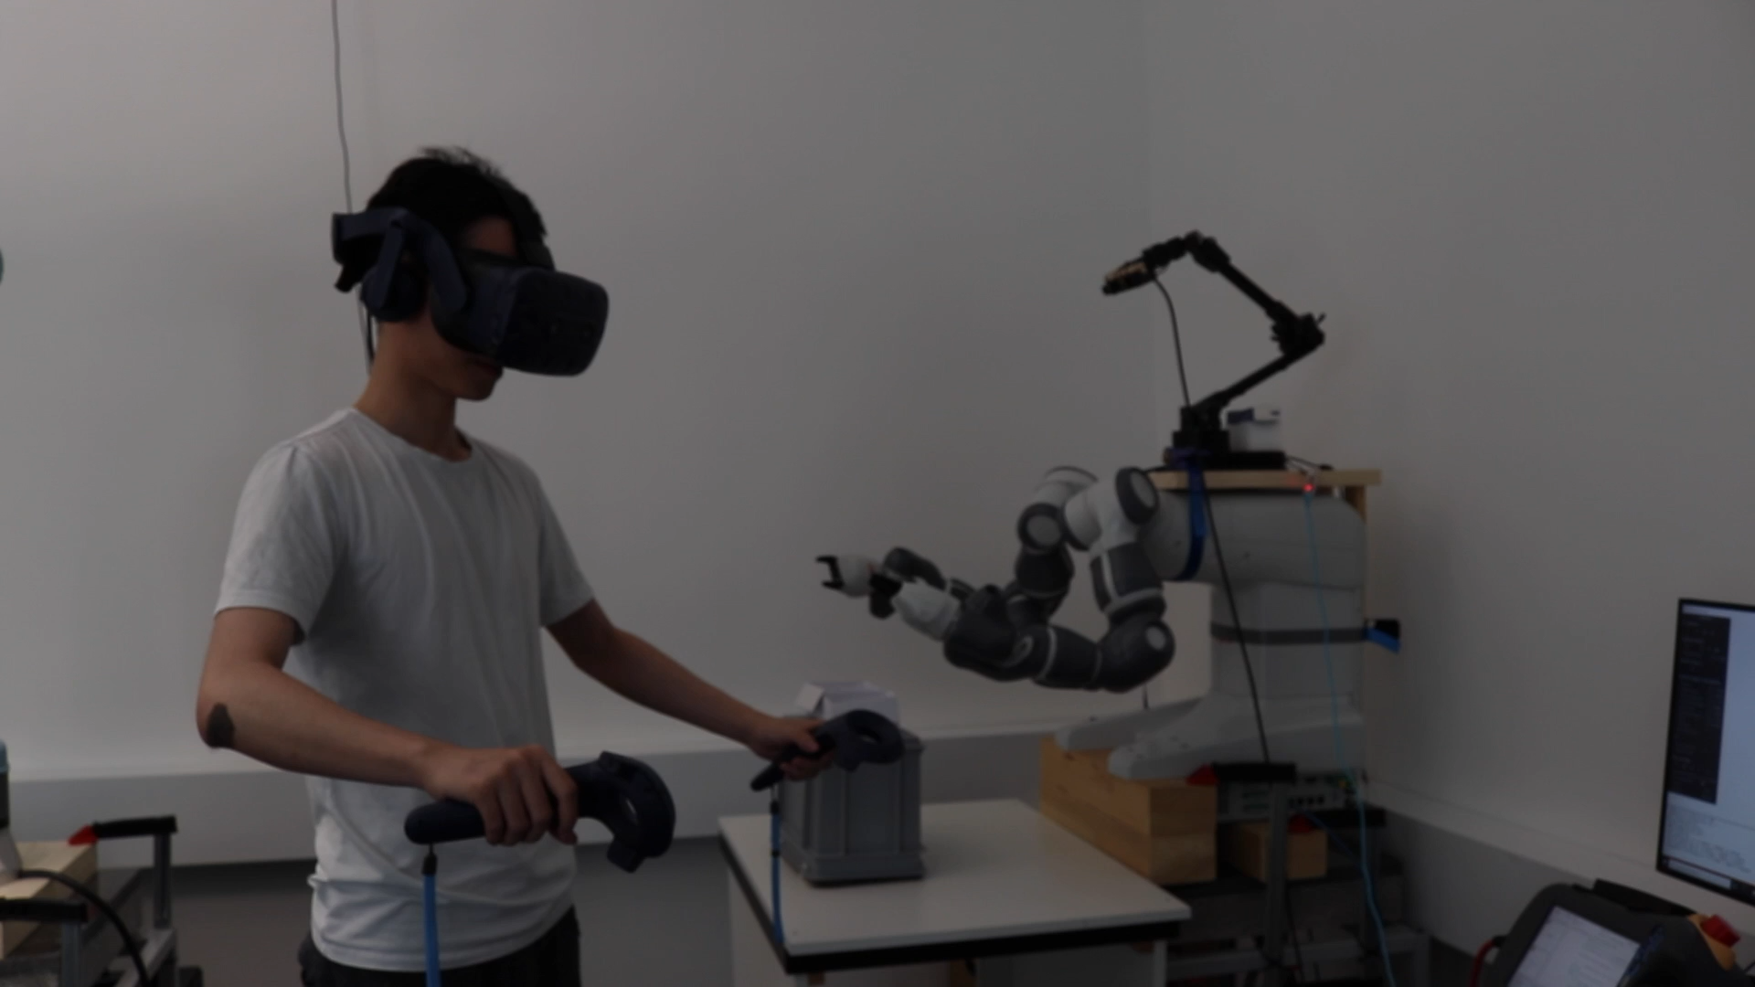

Slide 11
Project Timeline
Oct
Nov
Dec
Week 4
Week 5
Week 6
Week 7
Week 8
Week 9
Week 10
Week 11
Week 12
Week 13
Week 14
Communication Interface
Animated Robot Hologram
Manipulate Holographic Arms
Visualizing RGB Stream
Assembly Tasks
Immersive Teleoperation
Align Hologram with Robot, Show Future Movement
First Prototype
Interim Demo
Alpha Release
Beta Release
Final Demo

